Slide 1
Lecture 19: Standards and Regulations

Slide 2
Test Design Techniques
Specification-based Testing
Black-box Testing
Structure-based Testing
White-box Testing
Experience-based Testing

Slide 3
White-Box Testing/Structure-based Testing
There exist several popular white-box testing methodologies:
Statement coverage
branch coverage
condition coverage
path coverage
Control path
Data path

Slide 4
Testing with Use cases
Use cases
Business use case
Use cases represented by sequence diagram or activity diagram
Usually during acceptance testing
Pros
Comprehensible

Slide 5
Reference
Fundamentals of software testing by Bernard Homès
Available from the library website

Slide 6
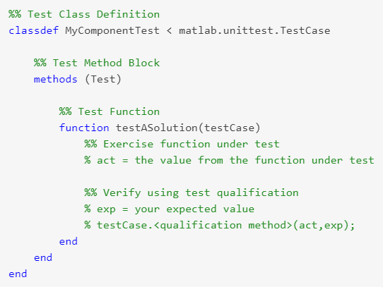
Class-based Testing in Matlab
testCase.verifyEqual

Slide 7
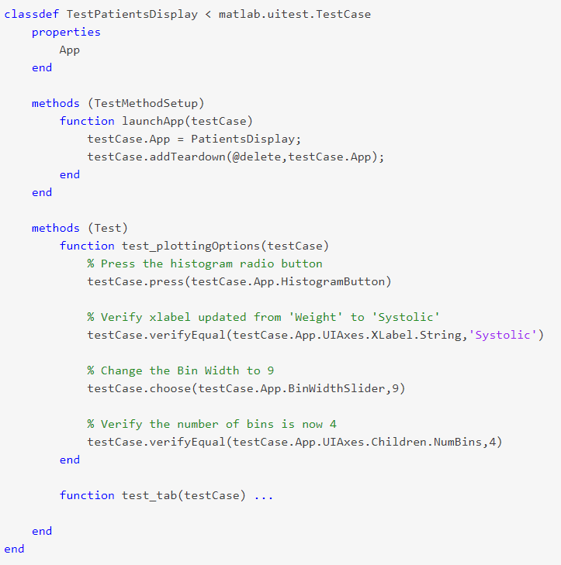
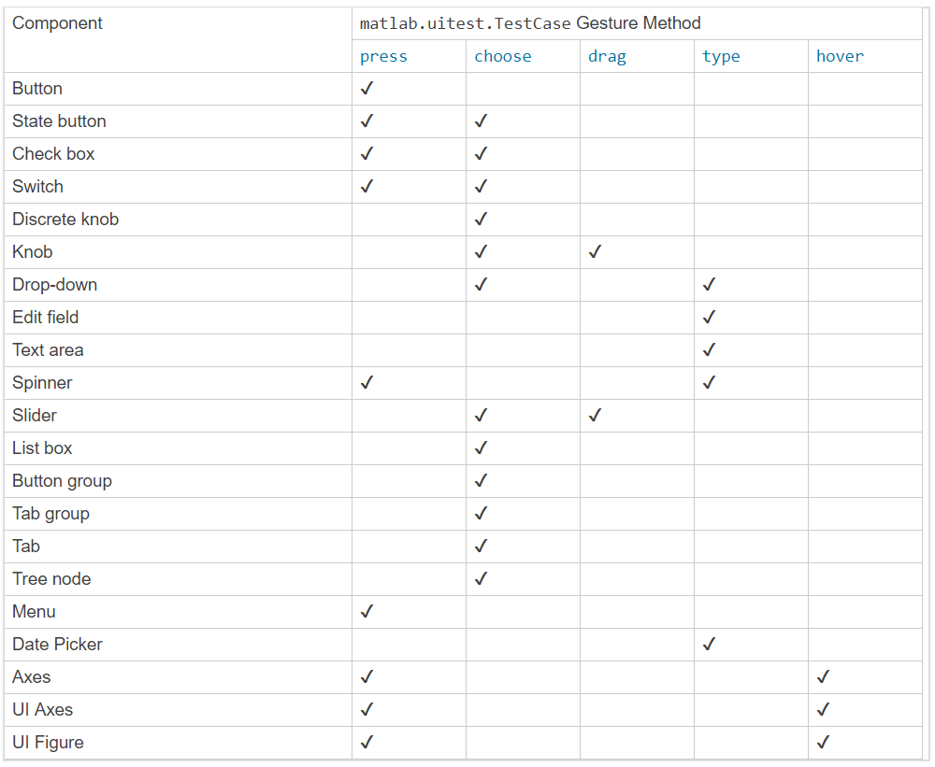
Testing APP

Slide 8
Traceability

Slide 9
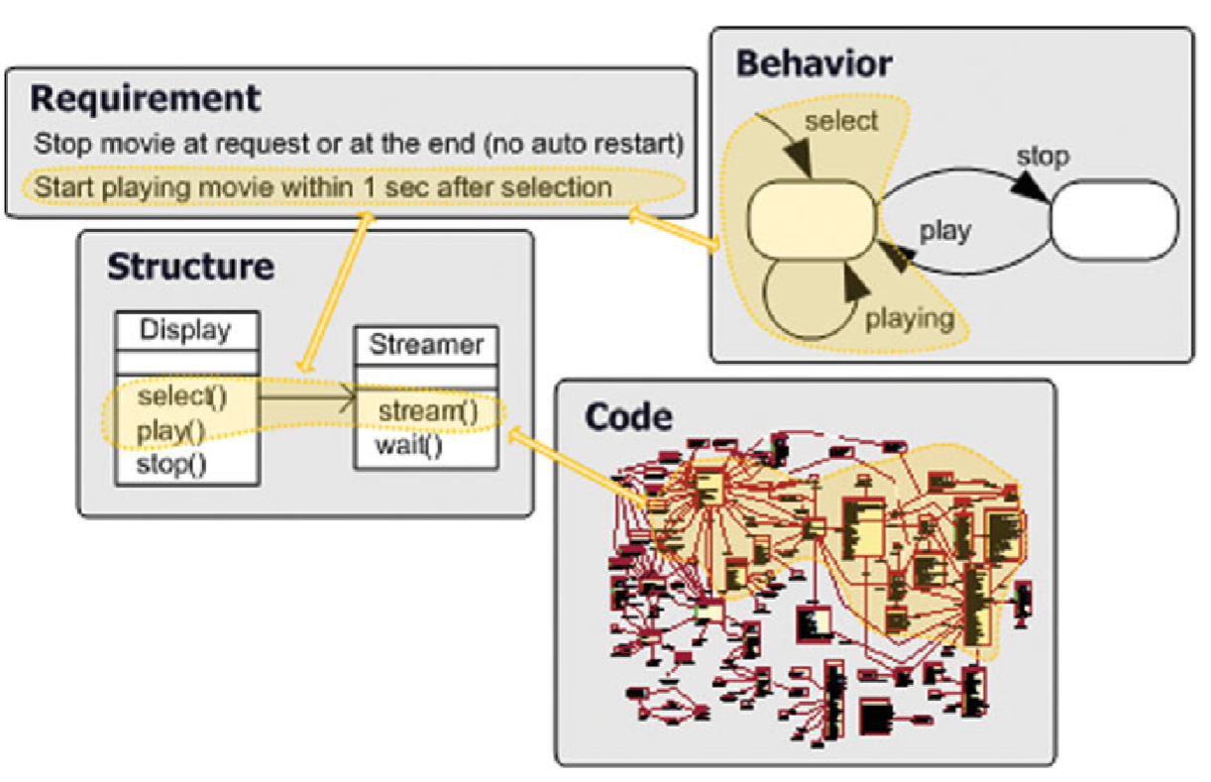
What is traceability?
We would like to make sure that
All requirements are implemented
All implementations are necessary
Trace artifacts
Requirements, models, code, etc.
Trace link
Association between two trace artifacts
Type: Refinement, Abstraction, Implementation, etc.
Trace granularity: component level, statement level, etc.
Trace quality: completeness, correctness, etc.
Test Suite
Test cases

Slide 10
Objectives of Traceability
Software lifecycle involves more than one person
Within the team
Make sure the requirements are faithfully translated to code
For the customers and regulation agencies
Part of validation evidence

Slide 11

Traceability Activities
Trace Creation
Establish trace link between a source artifact and a target artifact
Traceability document
Trace Validation
Between requirements and model: Model checking
Between concept model and implementation model: Model translation
Between model and code: Conformance testing
Trace Maintenance
Update trace when modification happened

Slide 12
Naming Rules
Requirements start with R
R1:
Specifications start with S
S1
S1.1
Test cases start with T
T1
Model checking properties start with M
M1

Slide 13
Traceability Report
Requirement | Implemented by | Validated by
R1 | S1 | T1.1, T1.2…

Slide 14
International Standards
Industry + regulation + academia develop standards
Regulation agencies adopt/recognize standards
Software companies comply to standards
Standards emphasize communication and shared understanding
For example: if one person says, “Testing is complete”, will all affected bodies understand what those words mean?
less time is spent on non-productive work

Slide 15
Benefits of Standards
Encapsulation of best practice
avoids repetition of past mistakes
Framework for quality assurance process
it involves checking standard compliance
Provide continuity
new staff can understand the organisation by the standards applied

Slide 16
Problems with standards
Small software organizations perceive them as being orientated towards large organizations.
Negative views of cost, documentation and bureaucracy
Difficult to relate standards to their business needs and to justify the application of the international standards in their operations

Slide 17
Who is the ISO?
International Organization for Standardization
world's largest developer of International Standards
A network of the national standards institutes of 162 countries, one member per country
ISO is a non-governmental organization that forms a bridge between the public and private sectors
Many of its member institutes are part of the governmental structure of their countries, or are mandated by their government
Other members have their roots uniquely in the private sector, having been set up by national partnerships of industry associations
This enables ISO to reach a consensus on solutions that meet both the requirements of business and the broader needs of society

Slide 18
Who develops ISO standards
By technical committees, (or subcommittees) comprising experts from the industrial, technical and business sectors
These experts may be joined by representatives of government agencies, consumer associations, non-governmental organizations and academic circles, etc.
Experts participate as national delegations, chosen by the ISO national member body for the country concerned.

Slide 19
How ISO standards are developed
The national delegations of experts of a committee meet to discuss, debate and argue until they reach consensus on a draft agreement
The resulting document is circulated as a Draft International Standard (DIS) to all ISO's member bodies for voting and comment
If the voting is in favor, the document, with eventual modifications, is circulated to the ISO members as a Final Draft International Standard (FDIS)

Slide 20
ISO/IEC JTC 1 SC7
ISO/IEC JTC 1 SC7
International Organization for Standardization/ International Electrotechnical Commission Joint Technical Committee 1 Sub-Committee 7
ISO/IEC JTC 1 SC7 Terms of Reference
“Standardization of processes, methods and supporting technologies for the engineering and management of software and systems throughout their life cycles”

Slide 21
SC7 Structure
SWG 5
SWG 1
Standards Management Group
SC7
Business Planning Group
Secrétariat
WG1A
WG7
WG21
WG25
IT Governance
Life Cycle
Management
Software
Asset Management
IT Service
Management
WG2
WG10
WG22
WG26
Systems & Software
Documentation
Process
Assessment
Vocabulary
Software Testing
WG4
WG19
WG23
WG42
Tools and
Environment
Techniques for
Specifying IT Systems
Systems Quality Management
Architecture
WG6
WG20
WG24
JWG ISO/TC 54
Software Product
Measurement and
Evaluation
Software Engineering
Body of Knowledge
SLC Profiles and
Guidelines for VSEs
CIF Usability
‡ Adapted from Prof. M. Azuma

Slide 22
Domains covered by SC7
Industrial
Engineering
Quality
Management
(ISO TC 176)
Project
Management
SOFTWARE and SYSTEMS
ENGINEERING
APPLICATION
DOMAINS
(many TCs)
Computer
Sciences and
Engineering
Dependability
Engineering
(IEC TC 56)
Safety (IEC TC65), Security, other mission-critical

Slide 23
Software Engineering Related Standards
Software-Development Standards
IEEE Std 830, Recommended Practice for Software Requirements Specifications
IEEE Std 1233, Guide for Developing System Requirements Specifications
IEEE Std 1016, Recommended Practice for Software Design Descriptions
IEEE Std 828, Standard for Software Configuration Management Plans
IEEE Std 1063, Standard for Software User Documentation
IEEE Std 1219, Standard for Software Maintenance

Slide 24
Software Engineering Related Standards
Software Quality-Assurance Standards
IEEE Std 730, Standard for Software Quality Assurance Plans
IEEE Std 1028, Standard for Software Reviews
IEEE Std 1008, Standard for Software Unit Testing
IEEE Std 829, Standard for Software Test Documentation
IEEE Std 1061, Standard for a Software Quality Metrics Methodology

Slide 25
Software Engineering Related Standards
Management Standards
IEEE Std 1058, Standard for Software Project Management Plans
IEEE Std 1074, Standard for Developing Software Life Cycle Processes
IEEE Std 1045, Standard for Software Productivity Metrics
IEEE Std 1062, Recommended Practice for Software Acquisition
IEEE Std 1540, Standard for Software Life Cycle Processes - Risk Management
IEEE Std 1490, Guide - Adoption of PMI Standard - A Guide to the Project Management Body of Knowledge

Slide 26
Regulated Industries

Slide 27
Regulated industries
Industries in which the failure of the products may cause social impacts
Aviation
FAA, etc
Nuclear
Medical
FDA
Automobile

Slide 28
Conflicting goals of regulators
Guarantee safety and effectiveness
Encourage the development and use of new technologies
Philosophy: Least Burdensome Approach

Slide 29
The goal of medical device certification
Ensure safety and effectiveness of medical devices
Safety: Whether probable benefits to health from use of the device outweigh any probable risks?
Effectiveness: Whether the use of the device in the target population will provide clinically significant results
The Food and Drug Administration (FDA) require safety & efficacy evidence provided by device manufacturers
Pre-market
Cleared/approved for sale on U.S. market
Post-market surveillance
Recall flawed devices

Slide 30
What are General Controls?
Basic authorities that provide FDA with the means to regulate medical devices.
Applies to all medical devices regardless of classification, are subject to premarket and postmarket regulatory controls.
Establishment registration and device listing
Premarket notification or 510(k), if not exempt
Labeling
Misbranding
Adulteration
Quality Systems
Records and Reports / Medical Device Reporting (MDR)
Notes:
Generally synonymous to Class I device. General controls include:
Establishment Registration (use FDA Form 2891) of companies which are required to register under 21 CFR Part 807.20, such as manufacturers, distributors, repackages and relabelers. Foreign establishments, however, are not required to register their establishments with FDA.
Medical Device Listing (use FDA Form 2892) with FDA of devices to be marketed.
Manufacturing devices in accordance with Good Manufacturing Practices (GMP) in 21 CFR Part 820.
Labeling devices in accordance with labeling regulations in 21 CFR Part 801 or 809.
Submission of a premarket notification [510(k)] before marketing a device.
Misbranding is False or Misleading labeling
Manufacturers. Importers and distributors must maintain records of reports to assure that devices are not adulterated and misbranded

Slide 31
What are Special Controls?
General controls alone are insufficient to assure safety and effectiveness of certain devices
Existing methods are available to provide such assurances.
Postmarket Surveillance Study
Patient Registries
Guidelines (e.g., Glove Manual)
Mandatory Performance Standard
Recommendations or Other Actions
Special Labeling (e.g., 882.5970, Cranial Orthosis)
Notes:
Class II - Special Controls
Class II devices are those for which general controls alone are insufficient to assure safety and effectiveness, and existing methods are available to provide such assurances. In addition to complying with general controls, Class II devices are also subject to special controls.
A few Class II devices are exempt from the premarket notification.
Special controls may include special labeling requirements, mandatory performance standards and postmarket surveillance.
Examples of Class II devices include powered wheelchairs, infusion pumps, and surgical drapes.

Slide 32
Device classifications
Whether control regulations can ensure the safety and effectiveness of medical devices
Class I
General controls can ensure safety and effectiveness
Class II
General controls not enough, need special controls
Class III
Insufficient information exists to determine that general and special controls are sufficient to provide reasonable assurance of the safety and effectiveness of such devices

Slide 33
Risk-based Classification
Classified according to its risks
 | Class I | Class II | Class III
Risk | Low | Medium | High
Clearance/Approval | Not required | Premarket Notification 510(k) | Pre-Market Approval (PMA)
Controls | General Controls | General & Special Controls 510(k) submission | General & Special Controls Premarket Approval (PMA)
Comparison | Not required | Predicate | Clinical Truth
Submission Studies | Not required | Preclinical/Clinical | Preclinical & Clinical
Notation | Marketed | Cleared | Approved

Slide 34
Pre-Market Notification 510(k)

Slide 35
Substantial Equivalence (SE)
Prove that the new device is substantially equivalent to a predicate device(s)
Philosophy: If there exists a device which has been proven to be safe and effective, and your new device is very similar to that device, your device may probably be safe and effective
Least burdensome principle by FDA
Only provide necessary (minimum required) information
Balance between risks and medical benefits

Slide 36
Predicate Device(s)
(i) was legally marketed prior to May 28, 1976 (pre-amendments device) and for which a PMA is not required;
“Grandfathered” devices
or (ii) has been reclassified from Class III to Class II or I;
or (iii) has been found Substantial Equivalent through the 510(k) process.

Slide 37
Predicate Selection
Is the predicate device legally marketed?
Do the devices have the same intended use?
Do the devices have the same technological characteristics?
Do the different technological characteristics raise different questions of safety and effectiveness?
Are the methods of evaluating new/different characteristics acceptable?
Does the data demonstrate substantial equivalence?

Slide 38
Technological Characteristics
Materials
Design
Energy Source
Other Features
Same ≠ Equivalent
Does not raise DIFFERENT issues of safety or effectiveness
Must be as safe and effective as predicate
Example: cutting with knife vs. cutting with laser

Slide 39
Class I / II 510(k) Exemptions
Over 800 generic types of Class I devices and 60 Class II devices are exempted from the premarket notification requirement (Federal Register)
510(k) Exempt Devices - approximately 47%
Class I 93%
Class II 9%
Devices exempt from 510(k) are:
“preamendment devices” not significantly changed or modified; or
Class I/II devices specifically exempted by regulation.
Notes:
The Food, Drug and Cosmetic Act under section 513(d)(2)(A) authorizes FDA to exempt certain generic types of Class I devices from the premarket notification [510(k)] requirement. FDA has exempted over 800 generic types of Class I devices and 60 class II devices from the premarket notification requirement. The 510(k) exemption is with certain limitations, which are so noted in ".9" of each chapter. It is important to confirm the exempt status and any limitations that apply with 21 CFR Parts 862-892 or the PRODUCT CODE CLASSIFICATION DATABASE or subsequent FR announcements on class I exemptions and class II exemptions. If a manufacturer's device falls into a generic category of exempted Class I devices as defined in 21 CFR Parts 862-892, a premarket notification application and FDA clearance is not required before marketing the device in the U.S.

Slide 40
Multiple Predicates
1 st Predicate has same intended use
2 nd Predicate has same technological characteristics
This is not allowed.

Slide 41
Multiple Predicates Allowed…
Evaluated on case-by-case basis
New performance testing required
Option 1: Two predicates with different technological characteristics, but the same intended use
Example: Hemodialysis catheter
Predicate A has same extension design
Predicate B has same tip design
Both A & B predicates have the same intended use
Options 2: More than one indication under the same intended use
Example: Fracture fixation plate
Predicate A is indicated for middle bone fractures
Predicate B is indicated for bone tip fractures
Both A & B predicates are intended for long bone fractures

Slide 42
A Device is NSE if:
There is no predicate device; or
It has a new intended use; or
It has different technological characteristics compared to the predicate device and it raises a different type question of safety and effectiveness; or
Pacemaker programmer Windows update
It does not demonstrate that it is at least as safe and effective as the predicate.
Approximately 3%-4%

Slide 43
The Special 510(k) Program
A modification of your 510(k) cleared device that you own
The modification does not alter the intended use or the fundamental scientific technology of the device
Submit only the documentation related to the modification that prompted the submission

Slide 44
Doubts regarding 510(k)
A loophole?
Most of the new pacemakers nowadays are cleared using 510(k)

Slide 45
Pre-Market Approval (PMA)

Slide 46
Pre-Market Approval (PMA)
Required for most Class III devices
Besides pre-amendment devices
The most stringent type of device marketing application required by FDA

Slide 47
PMA Review Stages
Pre-Sub meeting with FDA
Discuss: Device design Bench testing Animal testing Clinical trial
Investigational Device Exemption (IDE)
Request approval for clinical trial
PMA
Request market approval
PMA-S
Request approval for device change or upgrade (which may require a new IDE)

Slide 48
Data Requirements
Non-clinical Laboratory Studies Section:
Pre-clinical
Biocompatibility
Stress
Animal Tests
Clinical Investigations Section:
Study protocols
Safety and effectiveness data
Adverse reactions and complications
Device failures and replacements
Patient information
Results of statistical analyses

Slide 49
institutional review boards (IRBs)
An appropriately constituted group that has been formally designated to review and monitor biomedical research involving human subjects.
Has the authority to approve, require modifications in (to secure approval), or disapprove research
Determine whether a device study
Significant Risk (SR) Device Studies
Requires Investigational Device Exemption (IDE) application to FDA
Non-significant Risk (NSR) Device Studies

Slide 50
WHAT SHOULD IRBS CONSIDER WHEN MAKING THE SR AND NSR DETERMINATION?
What is the basis for the risk determination?
based on the proposed use of a device in an investigation, and not on the device alone.
What is the nature of harm that may result from use of the device?
Potential serious risk to the health, safety, or welfare of a subject
Will the subject need to undergo an additional procedure as part of the investigational study, for example, a surgical procedure?

Slide 51
SR & NSR Study Examples
A new pacemaker lead
SR, since additional procedure is needed
Extended wear contact lens
SR, wearing the lens overnight pose additional risks
Daily wear lenses
NSR

Slide 52
Investigational Device Exemption (IDE)
Allows the investigational device to be used in a significant risk clinical study
Can be used to collect safety and effectiveness data to support a PMA or a 510(k) submission
most often conducted to support a PMA
Risk to patient balanced by anticipated benefits
Device labeled for investigational use only

Slide 53
Type of IDEs
Feasibility study
May provide support for a future pivotal study or may be used to answer basic research questions
Not intended to be the primary support for a marketing application
Endpoints and sample size generally not statistically driven
Often required by FDA prior to pivotal study to assess basic safety and potential for effectiveness
Generally ~10-40 patients but may be larger
FDA review is primarily focused on safety and whether the potential benefit or value of the data justifies risk

Slide 54
Type of IDEs
Pivotal study
Generally intended as the primary clinical support for a marketing application
Designed to demonstrate a “reasonable assurance of safety and effectiveness”
Endpoints and sample size statistically driven
Designed to assess both safety and effectiveness
FDA review is much more complex

Slide 55
Level of Evidences
Randomized, multi-arm, “blinded” study
Randomized, multi-arm, un“blinded” study
Non-randomized study
Single-arm study with patient serving as own control
Single-arm study with Historical Control (using patient-level data)
Single-arm study with Objective Performance Criteria
Observational study
Systematic review (meta-analysis with patient-level data)
Meta-analysis based on summary information only
Literature Summary
Uncertain

Slide 56
Humanitarian Device Exemption (HDE)
Purpose: approval to market a class III (high risk) device for an unmet need in a patient population
Must first obtain designation as a Humanitarian Use Device (HUD) from the Office of Orphan Products (OOP)
An HDE is similar in both form and content to a premarket approval (PMA) application, but is exempt from the effectiveness requirements of a PMA.
HUD provision of the regulation provides an incentive for the development of devices for use in the treatment or diagnosis of disease affecting these populations.

